Slide 1



Bangla Bhojon
Restaurant Management System
Course: Object Oriented Programming Lab Language: Java GUI Framework: Java Swing
IDE: Netbeans
Date: 26/12/2025
Department of Software Engineering
01

Slide 2


PRESENTED TO
PRESENTED BY
Kazi Hasnayeen Emad
Dipankar Sarkar
Lab Lecturer
ID: 242034037
Department of Software Engineering
Green University of Bangladesh
Date: 26/12/2025
Bangla Bhojon
02

Slide 3

Introduction
Bangla Bhojon is a Java Swing based Restaurant Management System
It helps automate restaurant operations such as ordering and billing
The system is developed using Object Oriented Programming concepts
Date: 26/12/2025
Bangla Bhojon
03

Slide 4

Objectives
01
Implement OOP concepts practically
02
Design a user-friendly GUI with Java Swing
03
Manage automated order and billing
04
Improve problem-solving & software design skills
Date: 26/12/2025
Bangla Bhojon
04

Slide 5

Motivation Behind the Project
01
Manual billing is slow & error-prone
02
Small restaurants lack digital systems
03
Need auto bill calculation & receipts
04
Apply OOP concepts practically
Date: 26/12/2025
Bangla Bhojon
05

Slide 6




System Workflow
Admin
Login
Dashboard
Appears
Food Selection with Quantity
Bill Calculation & Receipt
Date: 26/12/2025
Bangla Bhojon
06

Slide 7
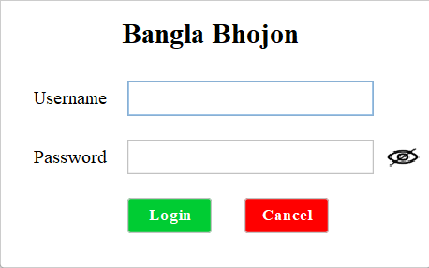
Login Module (1/4)
Date: 26/12/2025
Bangla Bhojon
07

Slide 8
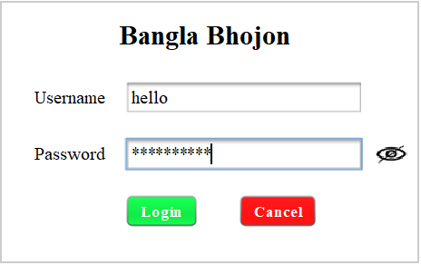
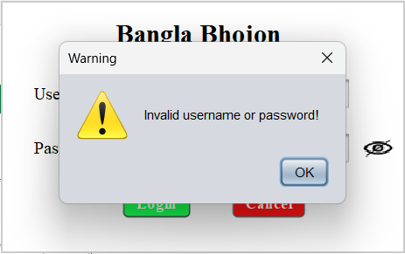
Login Module (2/4)
Date: 26/12/2025
Bangla Bhojon
08

Slide 9
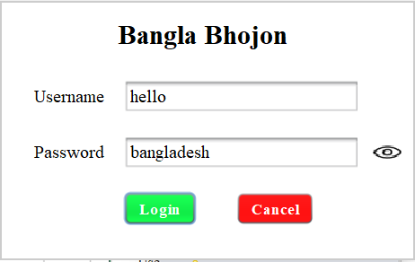
Login Module (3/4)
Date: 26/12/2025
Bangla Bhojon
09

Slide 10
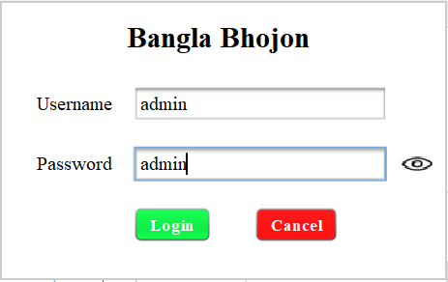
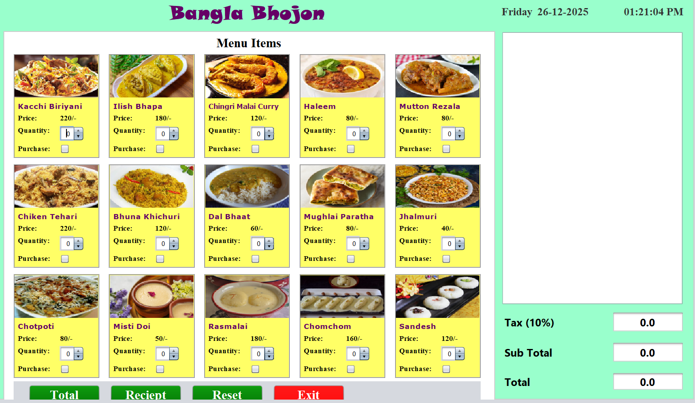
Login Module (4/4)
Date: 26/12/2025
Bangla Bhojon
10

Slide 11
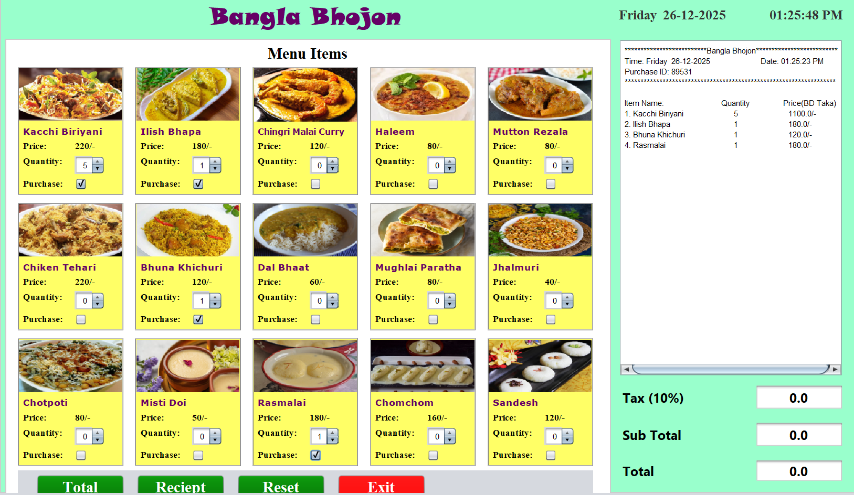
Dashboard (1/5)
Date: 26/12/2025
Bangla Bhojon
11

Slide 12
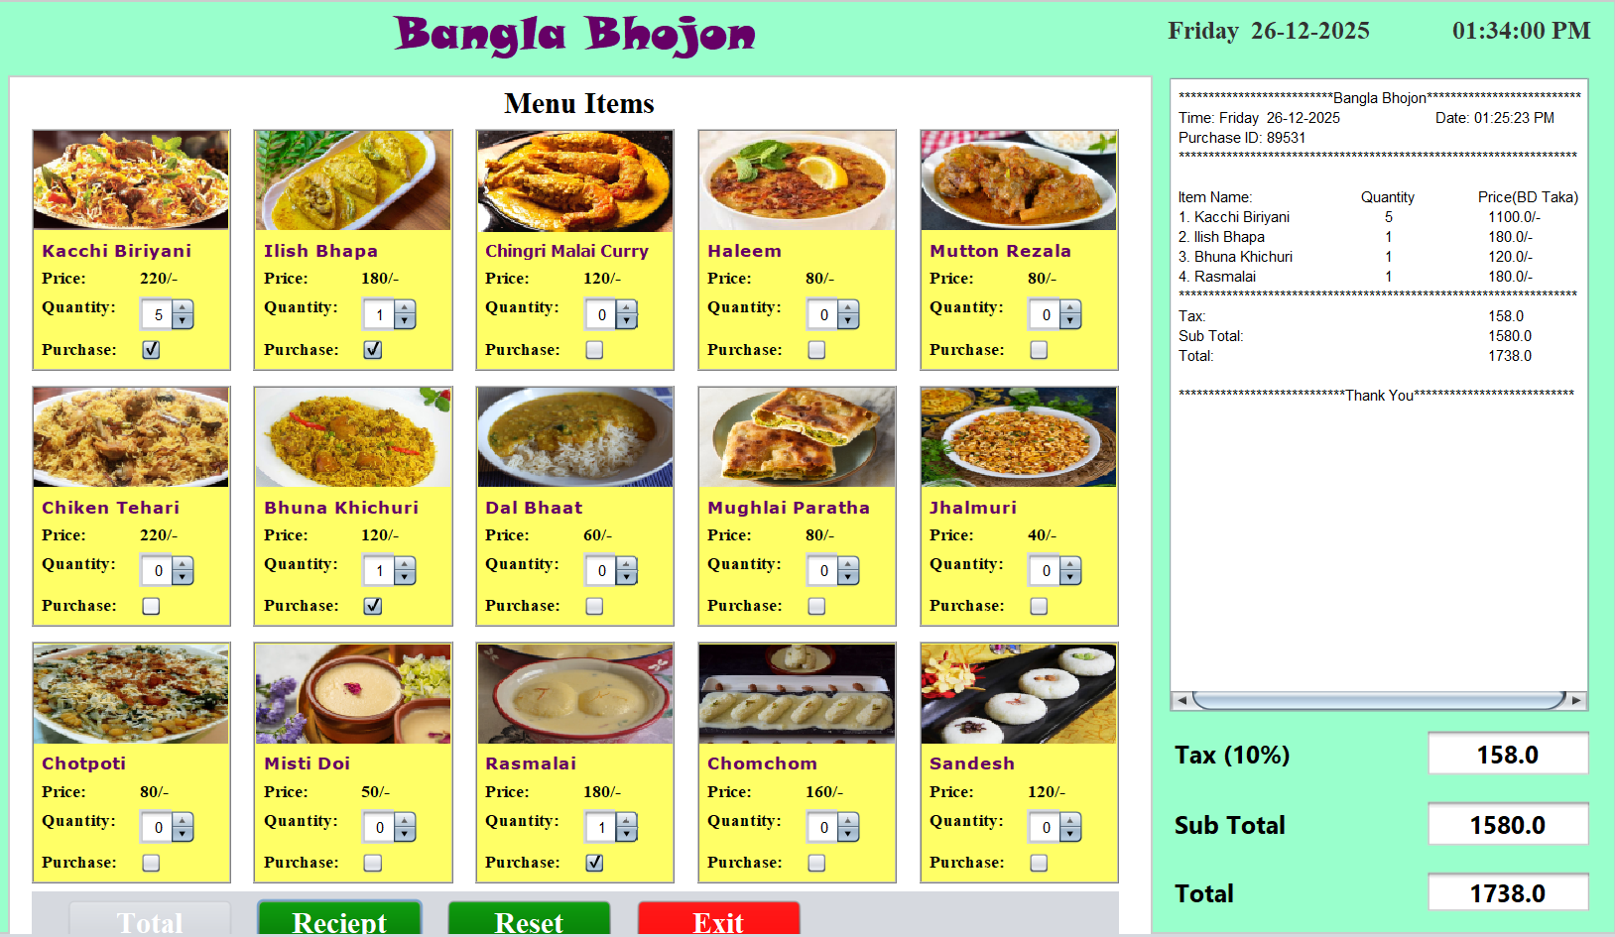
Dashboard (2/5)
Date: 26/12/2025
Bangla Bhojon
12

Slide 13
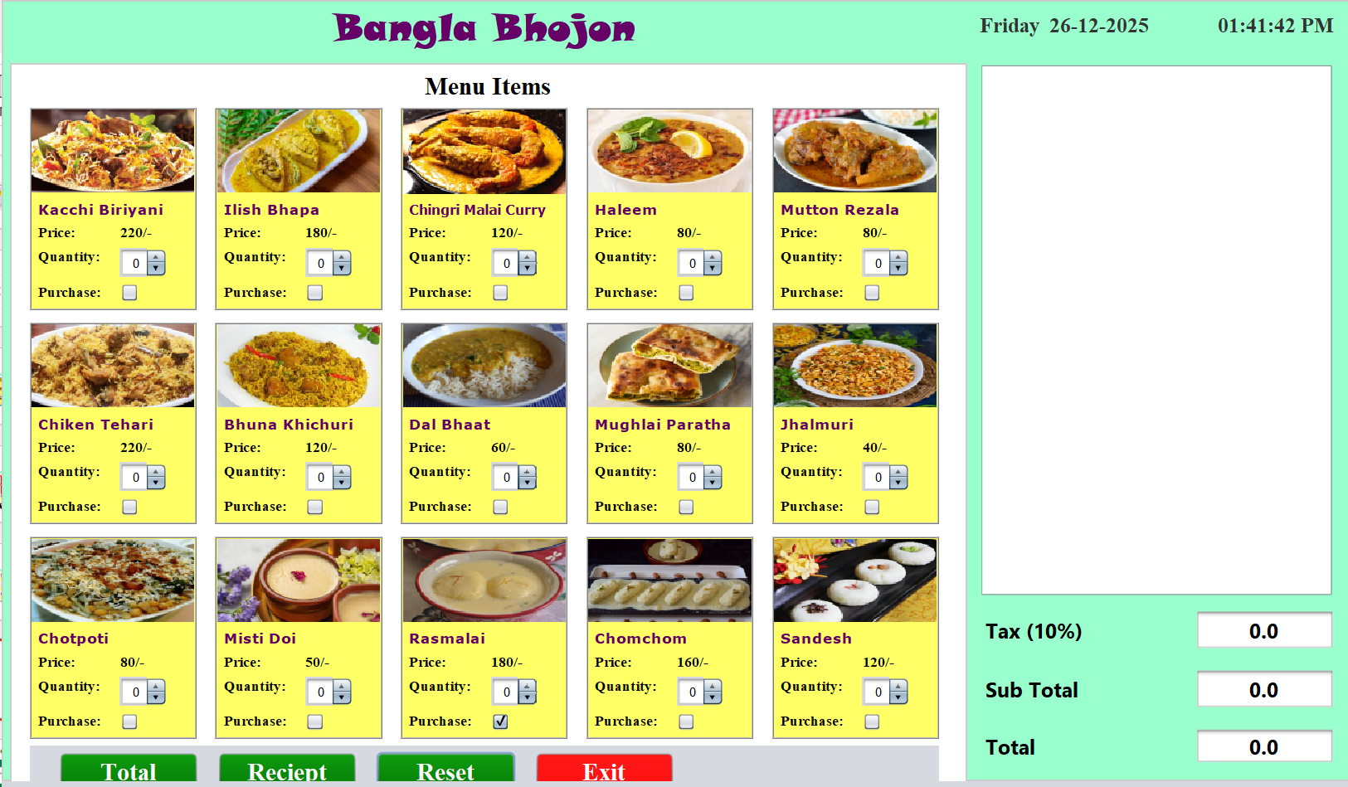
Dashboard (3/5)
Date: 26/12/2025
Bangla Bhojon
13

Slide 14
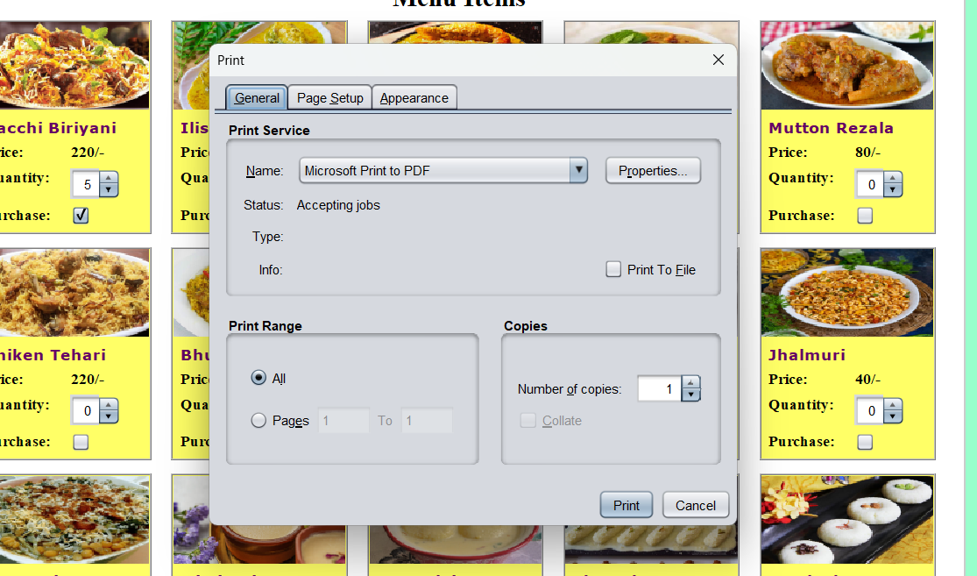
Dashboard (4/5)
Date: 26/12/2025
Bangla Bhojon
14

Slide 15
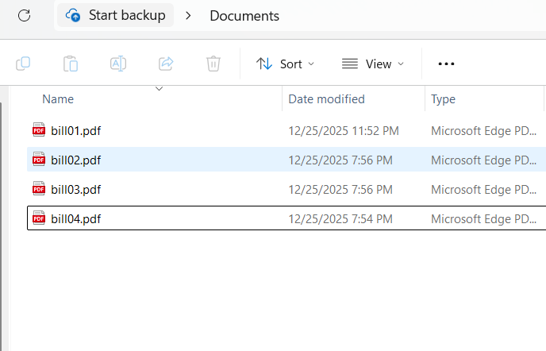
Dashboard (5/5)
Date: 26/12/2025
Bangla Bhojon
15

Slide 16


Tools and Technology used
01
Java
02
Java Swing
03
NetBeans IDE
04
Object Oriented Programming
Date: 26/12/2025
Bangla Bhojon
16

Slide 17
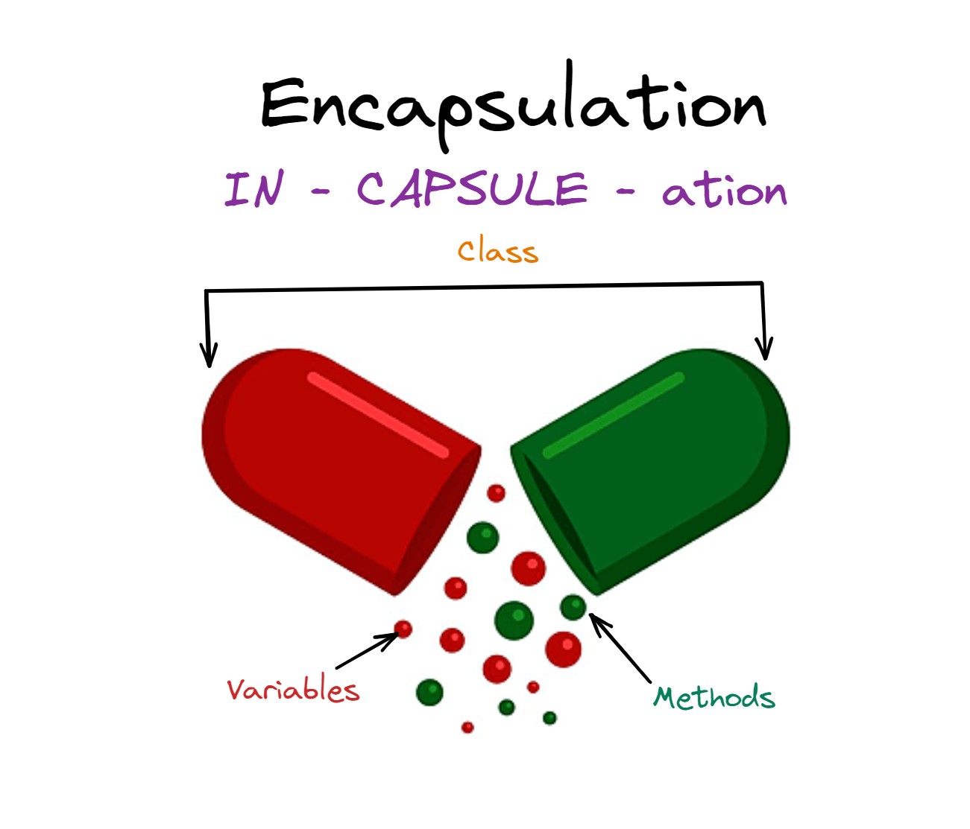
OOP Concept used
01
Class and Object
02
Encapsulation
03
Inheritance
04
Polymorphism
Date: 26/12/2025
Bangla Bhojon
17

Slide 18

Learning Outcomes
01
Strong understanding of OOP
02
Java Swing GUI development
03
Event handling
04
Real-life application design
Date: 26/12/2025
Bangla Bhojon
18

Slide 19
CONCLUSION
Bangla Bhojon is a successful implementation of object-oriented programming concepts in a real-life restaurant billing system.
Date: 26/12/2025
Bangla Bhojon
19

Slide 20

THANK YOU
Date: 26/12/2025
Bangla Bhojon
20

Slide 21



Any Question?
Feel free to ask
Date: 26/12/2025
Bangla Bhojon
21

